Slide 1



Taking insights about financial data into the AI-age.
Axel Barbelanne Tony Raffoul Charbel Raffoul
Elias Panner
March 19-21, 2025

Slide 2


Who would you trust with your money?
VS
Urs 20 yrs in wealth management
Some startup AI tool est. 2025

Slide 3

The stressful life of a Wealth Manager
CRM tool
newsfeed
PMS tool
scattered dashboards
clients’ historical data
market

Slide 4
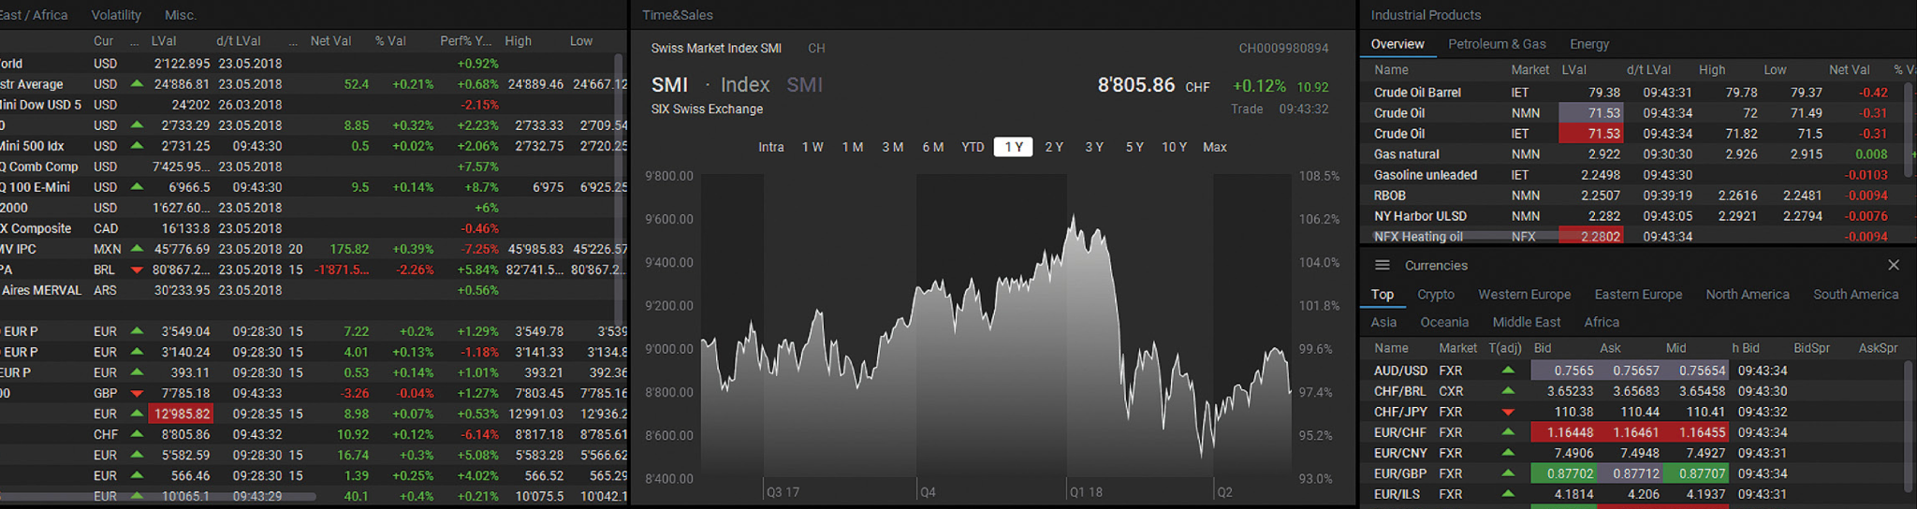

Building on SIX’s expertise
How can we take it to the next level?

Slide 5
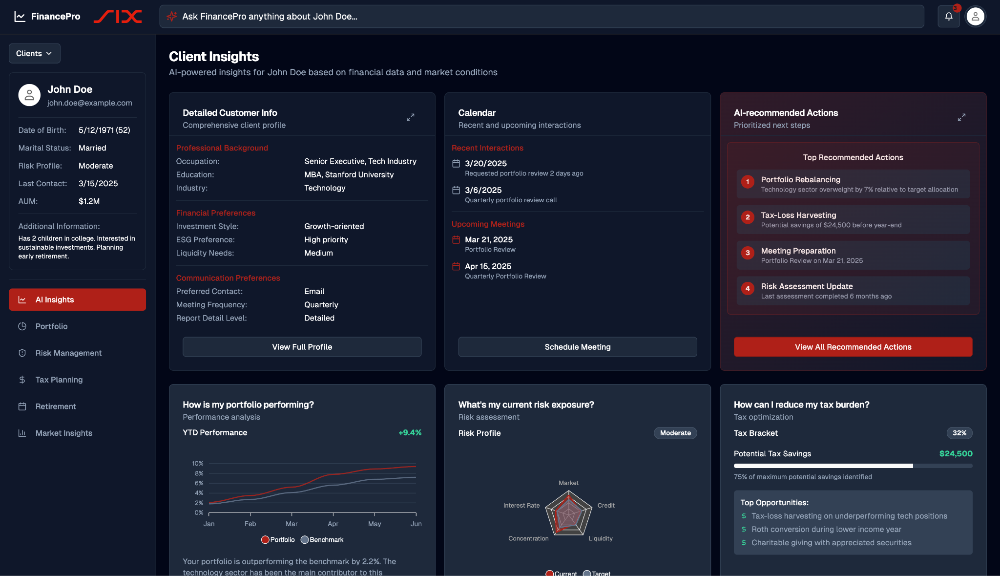
Solution: FinancePro
Client-Centric Design Real-time Insight Seamless Integration

Slide 6
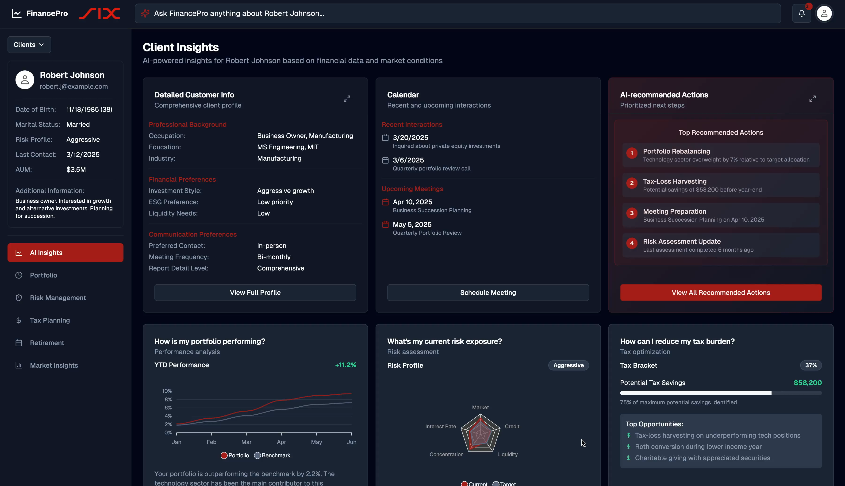

Slide 7
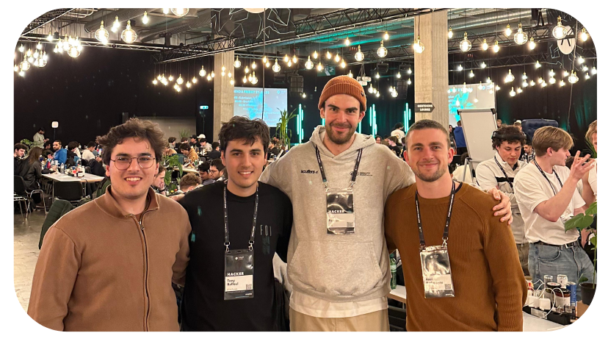
Team
Elias TU Wien, Business Informatics
Tony ETHZ, EE
Axel, ETHZ, Robotics
Charbel EPFL, CS

Slide 8


The Next Step
AND
Urs 20 yrs in wealth management
THE startup AI tool est. 2025

Slide 9
Questions?
If not, spread the word!

Slide 10





Appendix: Under the Hood
SIX API
Financial
Direct Interaction
RAG LLM
User data
Action Points
SerpApi
News

Slide 11
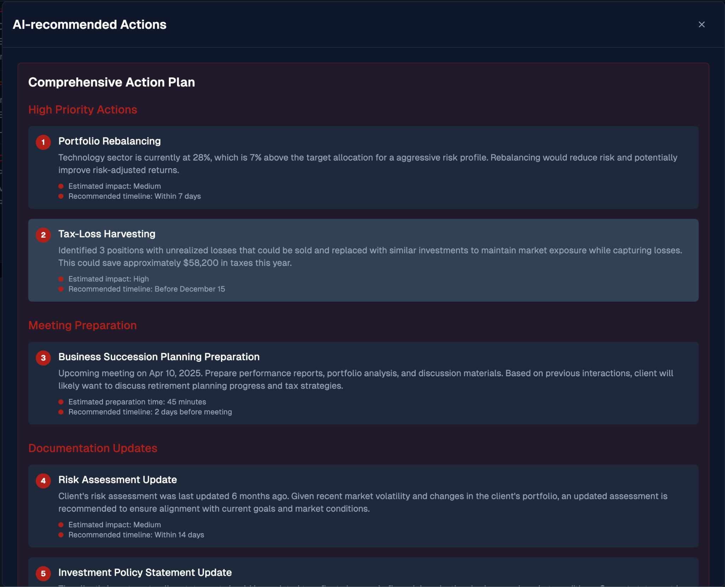
Appendix

